Slide 1
JDBC Practical Exercise Information

Slide 2
Overview
This practical creates an export utility for radio network cell performance data
JDBC is utilised to extract data from a relational performance management database
Query results are parsed and exported in Comma Separated Values (.CSV) format
CSV format can be read by external applications such as Microsoft Excel

Slide 3
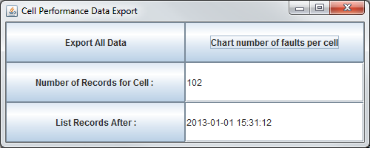
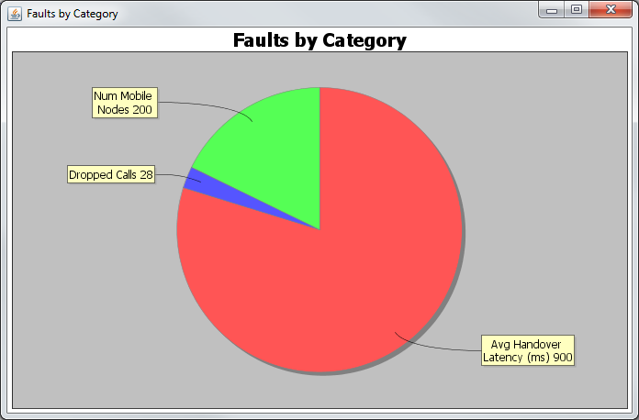
Screen Shot

Slide 4
Code Explanation
import java.sql.Connection;
import java.sql.DriverManager;
import java.sql.ResultSet;
import java.sql.ResultSetMetaData;
import java.sql.Statement;
These imports provide the relevant JDBC Functionality
import javax.swing.*;
import java.awt.*;
import java.awt.event.*;
These imports provide the Java Graphical User Interface (GUI) functionality

Slide 5
Code Explanation
import java.io.FileWriter;
import java.io.PrintWriter;
These imports will be used for exporting the data to CSV format
import org.jfree.chart.ChartFactory;
import org.jfree.chart.ChartFrame;
import org.jfree.chart.JFreeChart;
import org.jfree.data.general.DefaultPieDataset;
These imports will be used for the pie chart.

Slide 6
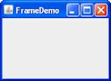
Code Explanation
class JDBCCellExample extends JFrame implements ActionListener {
This code defines a class called JDBCCellExample
JDBCCellExample “extends” from a JFrame. A JFrame is a type of window in Java. By extending (or “inheriting from” JFrame the class JDBCCellExample gets all the functionality that a JFrame has.
A Listener is an external process that listens for events to occur on the JFrame e.g mouse clicks, mouse movement.
The ActionListener is concerned with button clicks and it tells the Jframe when buttons are clicked.

Slide 7
Code Explanation
private JButton exportButton = new JButton("Export All Data");
This code creates a JButton called “exportButton”.
The text on the button is set to “Export All Data“
Note: The button is created but it is not yet attached to the Jframe
private JButton totalDroppedCallsButton = new JButton("Total Number of Dropped Calls");
private JButton numRecForCellButton = new JButton("Number of Records For Cell : ");
private JButton recordsAfterButton = new JButton("List Records After :");
private JTextField cellIDTF=new JTextField(12);
private JTextField timeTF=new JTextField(12);
This code creates 3 further buttons called; totalDroppedCallsButton, numRecForCellButton and recordsAfterButton
2 text fields which are 12 characters in size are also created called; cellIDTF and timeTF

Slide 8
Code Explanation
private Connection con = null;
private Statement stmt = null;
This code creates 2 attributes “con” and “stmt”
con will store of the details of the connection to the database
stmt will represent the SQL query which will be ran against the DB

Slide 9
Code Explanation
public JDBCCellExample(String str) {
This is the constructor for the class JDBCCellExample. It is a method with no return type and the same name as the class. It has the effect of constructing or putting the new Jframe window into memory.
super(str);
super() calls the constructor of the parent class (JFrame). This has the effect of setting the title on the Jframe to String str.
getContentPane().setLayout(new GridLayout(3,2));
A Jframe is split into 2 parts (1) a menu bar (2) a content pane (the main window of the frame). This line of code splits the main window of the frame into a grid of 3 rows and 2 columns
initDBConnection();
This is the call to the initDBConnection() method (described later)

Slide 10
Code Explanation
getContentPane().add(exportButton);
When the buttons and textfields were created they were not added to the frame. This code adds the exportButton to the content pane i.e. the main window on the Frame
exportButton.addActionListener(this);
This code adds a listener to the exportButton. If the button is clicked “this” class (JDBCCellExample) will be informed by calling the actionPerformed() method.
setSize(500,200);
Set the size of the Frame to 500 X 200 pixels
setVisible(true);
Make the Frame visible to the end user

Slide 11
Code Explanation
private void initDBConnection(){
try{
Class.forName("com.mysql.jdbc.Driver");
// Load the driver to connect the Java process to the DB
String url="jdbc:mysql://localhost:3306/NW_Stats";
// Identify the DB
// localhost – the DB is located on this computer
// 3306 – the port number to connect to the DB on
// “NW_Stats” – the name of the DB
con = DriverManager.getConnection(url, "root", "admin");
// create a connection to a DB with user name “root”
// and password “admin”
stmt = con.createStatement();
// Using the connection to the DB create a Statement
// object which will be used to run SQL queries against the DB
// You may also setup a preparedStatement here
}

Slide 12
Code Explanation
public void actionPerformed(ActionEvent e){
// When the button is clicked the listener will call the
// actionPerformed() method. The ActionEvent object e will
// identify which of the buttons was clicked.
Object target=e.getSource();
// Determine which of the buttons was clicked
ResultSet rs=null;
// the rs object will store the results returned from the DB
String cmd = null;
// cmd will store the SQL query which will be ran against the DB
if (target.equals(exportButton)){
// If the button pressed was the exportButton…
//set cmd to write out all the table data to the csv
// Create the SQL command which will be ran against the DB
}

Slide 13
Code Explanation
rs= stmt.executeQuery(cmd);
// Run the SQL statement stored in the variable “cmd” against the DB
// The results of the query are returned and stored in the object “rs”
writeToFile(rs);
// This is the call to our method writeToFile()
// The result set received from the DB is passed to the method

Slide 14
Code Explanation
private void writeToFile(ResultSet rs){
// The method is called and the result set from the DB is received
try{
FileWriter outputFile = new FileWriter("CellOutput.csv");
// A new file called “CellOutput.csv” will be created using a Filewriter
PrintWriter printWriter = new PrintWriter(outputFile);
// The “outputFile” object is passed to a PrintWriter so the file can be written to
ResultSetMetaData rsmd = rs.getMetaData();
// A result set has Meta Data (Data about Data) associated with it
// this code extracts the meta data from the result set
int numColumns = rsmd.getColumnCount();
// Using the meta data from the result set we determine the number of columns in the
// result set. Depending on the query executed there maybe different numbers if
// columns

Slide 15
Code Explanation
for(int i=0;i<numColumns;i++){
printWriter.print(rsmd.getColumnLabel(i+1)+",");
}
printWriter.print("\n");
This code prints the column headings to the file “CellOutput.csv” using the printWriter
The for loop iterates up to the number of columns. Remember this maybe different numbers depending on the type of query executed.
System.out.print() prints content to the screen. printWriter.print() will print content to the file
rsmd.getColumnLabel(i) uses the result set meta data to get the name of column i. The column labels start at 1 not 0 so we insert an i+1.
In CSV format entries are separated by , the code +",“ adds a , between the entries to comply with CSV format
Println includes a carriage return “\n” print does not hence the final “\n” added at the end of the loop

Slide 16
Code Explanation
while(rs.next()){
rs.next() gets the next row in the result set. If the result set is empty “false” is returned. This code continues while there still are entries in the result set
for(int i=0;i<numColumns;i++){
Noted the nested loop (while/for). While for rows and for loop for the columns in that row. For each cell in the row.
printWriter.print(rs.getString(i+1)+",");
getString(i) reads the value of cell I from the result set. The cells start from 1 so we use i+1 for the first cell in the row.
The enteries are seperated by , as in the column headings
printWriter.print("\n");
At the end of the row place a new line
printWriter.flush();
To ensure contents are written to file immediately the buffer between the java process and the file is flusehed to push the contents to the file.

Slide 17
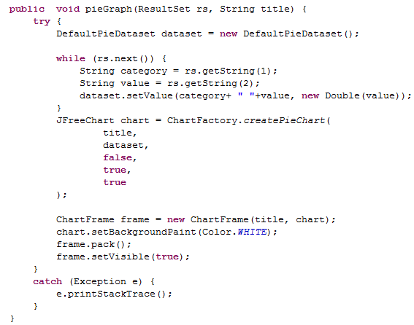
The PieChart
pieGraph takes in the ResultSet
and a ttitle
Not displaying a legend for this chart

Slide 18
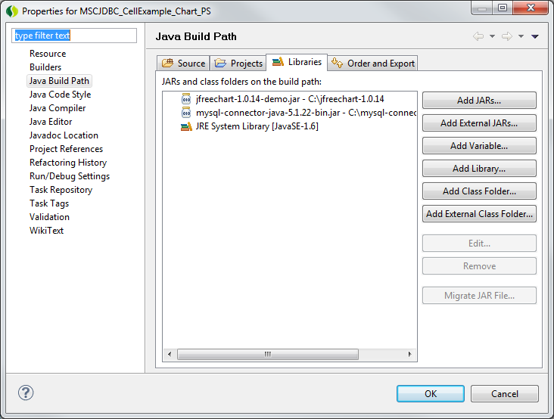
Create the Java Project
Create new Java project with the JDBCCellExample class (available on Moodle)
To run the project you will need
  Run NW_Stats script from Moodle to create your database
  Edit the Project Properties -> Java Build Path -> Add External Jar to include the mysql-connector-java-5.1.22 (available on Moodle)
  You also need to include the jfreechart lib (also on Moodle)

Slide 19
Complete the Event Handling
Only two of the buttons work
Update the actionPerformed for the remaining 2 buttons
Note the use of the PreparedStatement for the numRecForCellButton

